Slide 1

ECE 1710: Power Distribution Engineering and Smart Grids
Lecture 10
Dr. Robert Kerestes
University of Pittsburgh
Swanson School of Engineering
Department of Electrical and Computer Engineering
Notes:
Instructions for editing school and department titles:
Select from menu: View > Master > Slide Master
Click on each text area you wish to edit. Text will become editable.

Slide 2
Outline
Outline of Lecture No. 10
Module #1: Exact line segment model
Module #2: Calculations for line models
Module #3: Line calculation example

Slide 3
Learning Objectives
Learning Objectives:
Determine generalized line constant matrices
Solve for line voltages and currents using line constant matrices and source/load conditions
Solve for voltage unbalance and determine whether it falls within NEMA standards for induction machine operation
Solve for voltage drops three-wire delta connected distribution lines
Solve for ground current in three-phase distribution lines

Slide 4
Exact line segment model

Slide 5
Exact line segment model
Now that we’ve produced line models, the question is what can we do with them?
Can properly calculate voltage drop down a line segment
Can model conductor heat due to current
Can determine if cables are overloaded due to their ampacity constraints

Slide 6
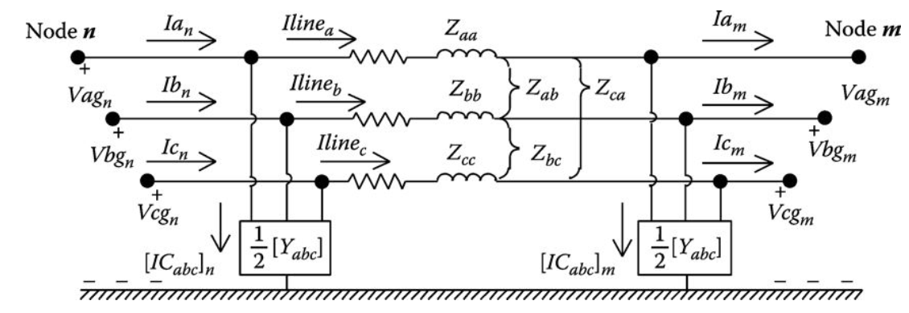
Exact line segment model
The model of a three-phase, two-phase, or single-phase overhead or underground line is shown in below

Slide 7
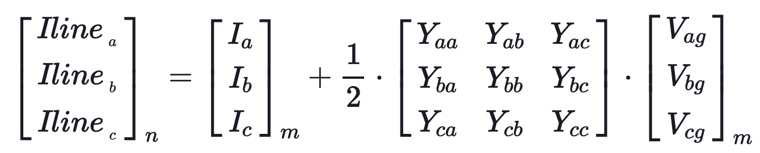

Exact line segment model
For the line segment shown above, the equations relating the input (node n) voltages and currents to the output (node m) voltages and currents are developed as follows. Kirchhoff’s Current Law applied at node m:

Slide 8
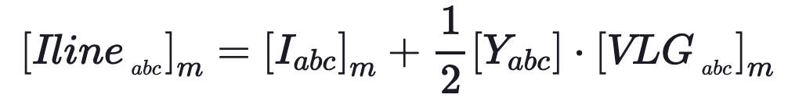
Exact line segment model
In condensed form the line current equation is

Slide 9
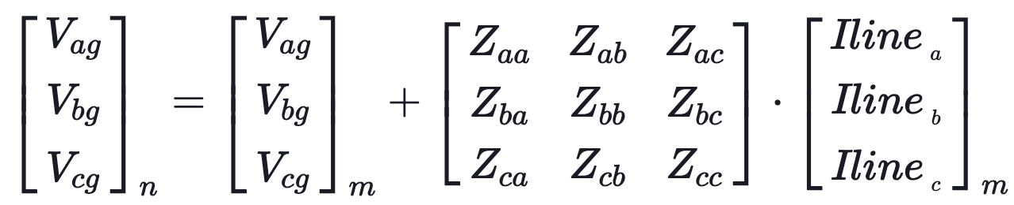
Exact line segment model
Kirchhoff’s Voltage Law applied to the model gives:

Slide 10
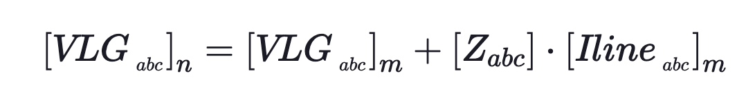
Exact line segment model
The voltage line to ground voltage equation in condensed form is

Slide 11
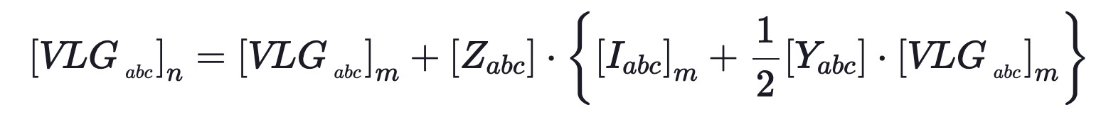
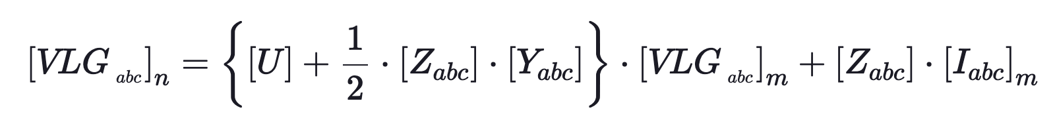
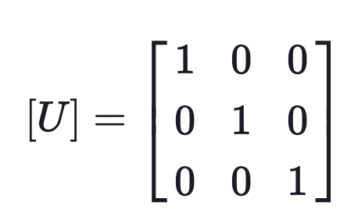
Exact line segment model
Substituting the line current into the voltage equation we have
Collecting terms
where

Slide 12
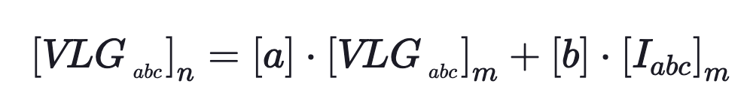
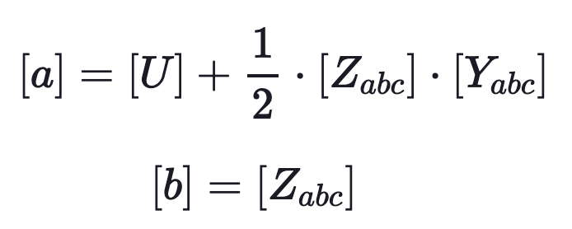
Exact line segment model
We which we can rewrite as
where:

Slide 13
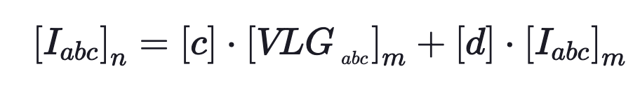
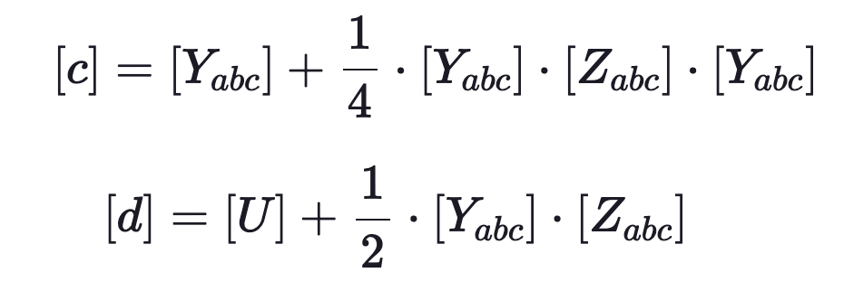
Exact line segment model
We can perform a similar derivation (see textbook) to derive
where:

Slide 14
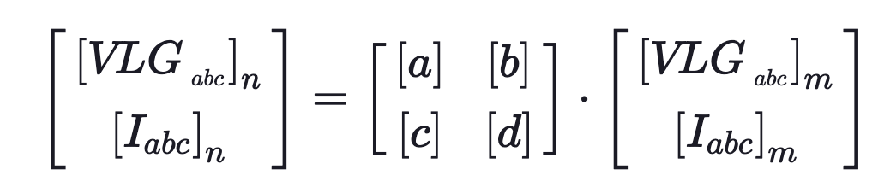
Exact line segment model
And in partitioned matrix form we have:

Slide 15
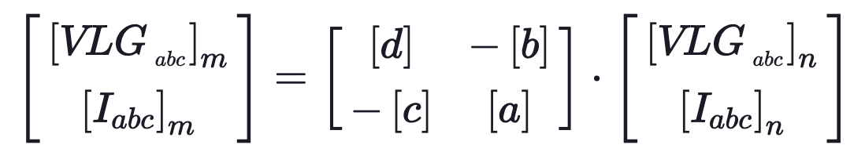
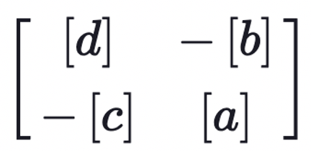
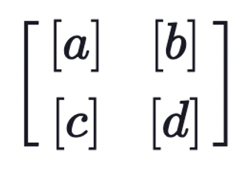
Exact line segment model
We can also solve this for voltages and currents at node m, in terms of voltages and currents in terms of node n by inverting and pre-multiplying
Because
is the inverse of

Slide 16
Exact line segment model
We can also solve this for voltages and currents at node m, in terms of voltages and currents in terms of node n by inverting and pre-multiplying
Because
is the inverse of

Slide 17
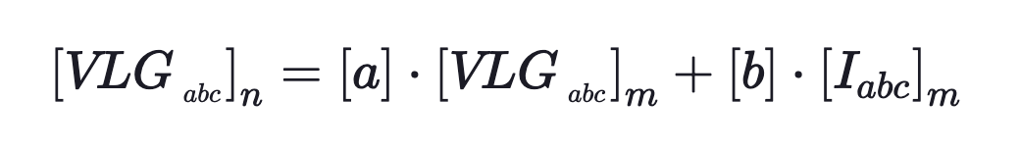
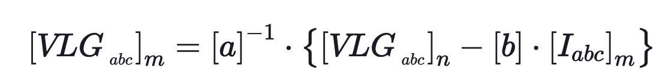
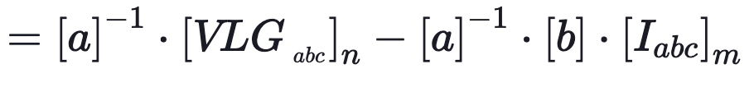
Exact line segment model
Sometimes it is necessary to compute the voltages at node m as a function of the voltages at node n and the currents entering node m. Solving for the voltage at node m.

Slide 18
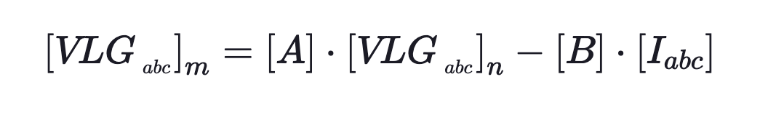
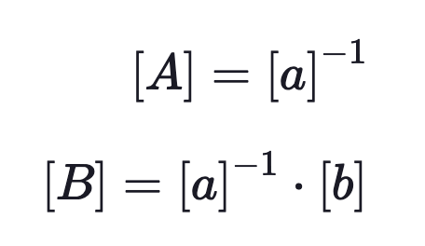
Exact line segment model
Which we can rewrite as
where

Slide 19
Calculations for Line Models

Slide 20
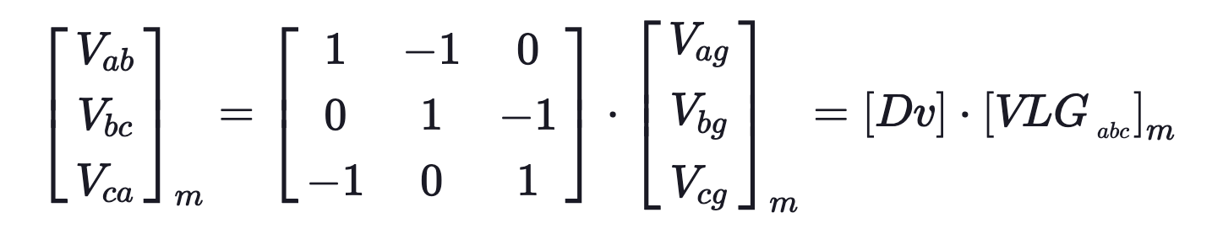
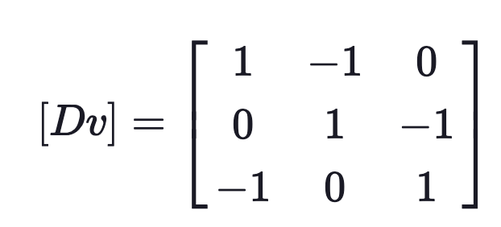
Calculations for Line Models
Line-to-line voltage
It is often that line-to-line voltages are of interest. These are the difference of line-to-ground voltages:
where

Slide 21
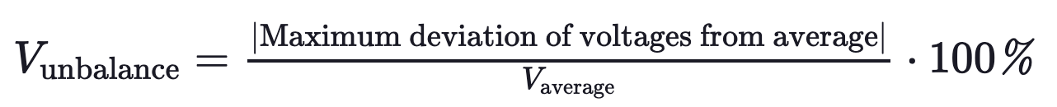
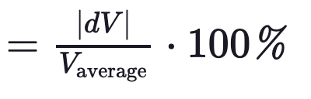
Voltage Unbalance
Because the mutual coupling between phases on the line segments is not equal, there will be different values of voltage drop on each of the three phases.
As a result the voltages on a distribution feeder become unbalanced even when the loads are balanced.
A common method of describing the degree of unbalance is to use the National Electrical Manufactures Association (NEMA) definition of voltage unbalance:

Slide 22
Calculations for Line Models
It is important to know that NEMA standards require that induction motors be derated when the voltage unbalance exceeds 1.0%.

Slide 23
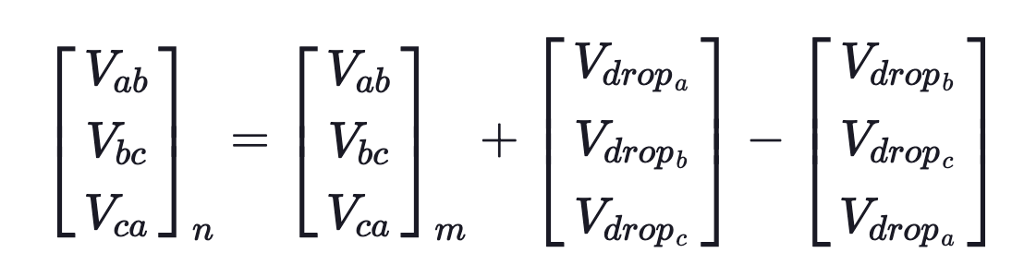
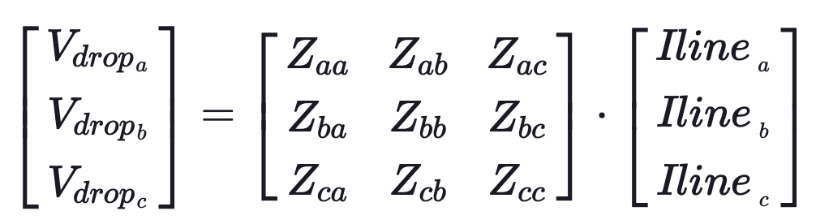

Calculations for Line Models
Equivalent line-to-neutral voltage
For delta connected lines voltage drops must be written in terms of line-to-line voltages because line-to-neutral (line-to-ground) does not exist:
where:

Slide 24
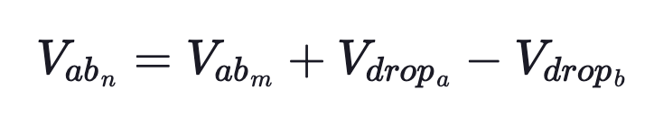
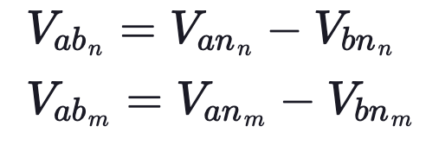
Calculations for Line Models
Looking at phase a-b:
But:

Slide 25
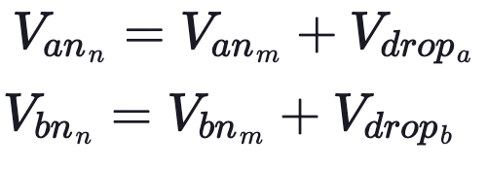
Calculations for Line Models
Substituting:
or:

Slide 26
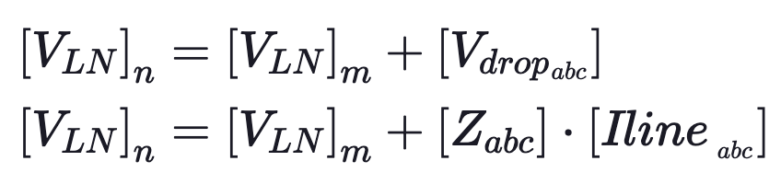
Calculations for Line Models
In general, this can be broken into terms of “equivalent” line-to-neutral voltages.
So it is possible to work with these equivalent line-to-neutral voltages for delta connected lines. This is identical to wye circuit calculations.

Slide 27
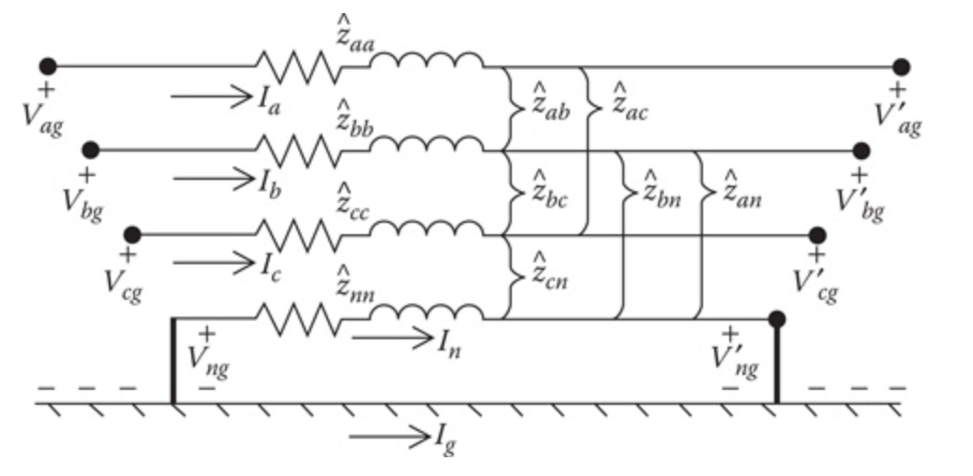
Calculations for Line Models
Neutral and ground currents
The Kron reduction method was used to reduce the primitive impedance matrix to the 3 × 3 phase impedance matrix. The figure below shows a three-phase line with grounded neutral that is used in the Kron reduction.

Slide 28
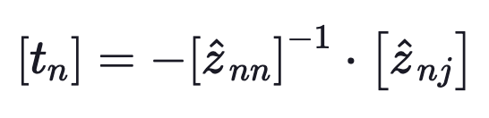
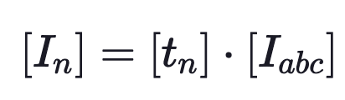
Calculations for Line Models
In the development of the Kron reduction method, we defined the “neutral transform matrix” [tn].
This matrix is used to calculate the currents flowing through the neutral wire(s)

Slide 29
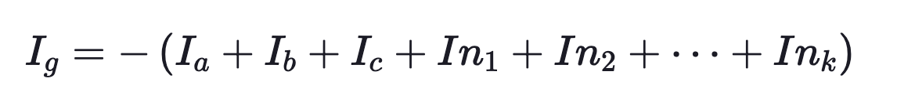
Calculations for Line Models
We can then use KCL to calculate the currents flowing into the ground

Slide 30
Line calculation example

Slide 31
Line Calculation Example
Example: A balanced three-phase load of 6000 kVA, 12.47 kV, 0.9 lagging power factor is being served at node m of a 10,000 ft three-phase line segment. The load voltages are rated and balanced 12.47 kV. The configuration and conductors of the line segment are those on the next slide
Determine the generalized line constant matrices [a], [b], [c], [d], [A], and [B].
Using the generalized matrices determine the line-to-ground voltages and line currents at the source end (node n) of the line segment.
Determine the voltage unbalance for this system.

Slide 32
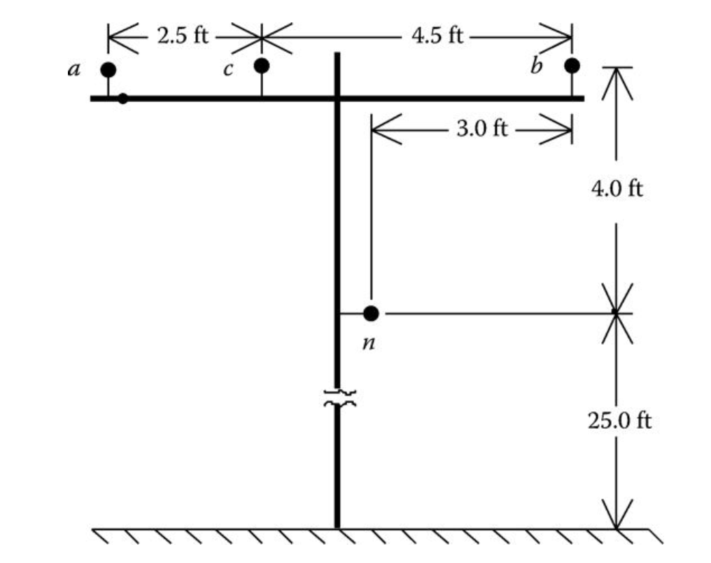
Line Calculation Example
Phase conductors:
336,400 26/7 ACSR
Neutral conductor:
4/0 6/1 ACSR

Slide 33
Line Calculation Example
First calculate the phase impedance matrix:
z_{abc} =
0.4571 + j1.0791 0.1556 + j0.5027 0.1531 + j0.3860
0.1556 + j0.5027 0.4663 + j1.0492 0.1576 + j0.4247
0.1531 + j0.3860 0.1576 + j0.4247 0.4611 + j1.0661
Ω/mi
Then we must find the lumped parameter impedance, by multiplying this matrix by 10,000/5280

Slide 34
Line Calculation Example
The lumped parameter phase impedance matrix:
Z_{abc} =
0.8658 + j2.0438 0.2947 + j0.9521 0.2900 + j0.7310
0.2947 + j0.9521 0.8831 + j1.9871 0.2986 + j0.8043
0.2900 + j0.7310 0.2986 + j0.8043 0.8733 + j2.0192
Ω

Slide 35
Line Calculation Example
Next calculate the phase shunt admittance matrix:
y_{abc} =
0.0000 + j5.6711 0.0000 - j1.8362 0.0000 - j0.7033
0.0000 - j1.8362 0.0000 + j5.9774 0.0000 – j1.1690
0.0000 - j0.7033 0.0000 - j1.1690 0.0000 + j5.3910
μS/mi

Slide 36
Line Calculation Example
The lumped parameter phase admittance matrix:
Y_{abc} =
0.0000 + j10.7408 0.0000 - j3.4777 0.0000 - j1.3321
0.0000 - j3.4777 0.0000 + j11.3208 0.0000 - j2.2140
0.0000 - j1.3321 0.0000 - j2.2140 0.0000 + j10.2103
μS

Slide 37
Line Calculation Example
Next finding the generalized line constant matrices [a], [b], [c], [d], [A], and [B]

Slide 38
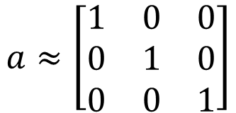
Line Calculation Example
a =
1.0000 + j0.0000 -0.0000 - j0.0000 -0.0000 + j0.0000
-0.0000 - j0.0000 1.0000 + j0.0000 -0.0000 + j0.0000
-0.0000 + j0.0000 -0.0000 + j0.0000 1.0000 + j0.0000
$$a≈\left[\begin{matrix}1 & 0 & 0 \\ 0 & 1 & 0 \\ 0 & 0 & 1\end{matrix}\right]$$

Slide 39
Line Calculation Example
b =
0.8658 + j2.0438 0.2947 + j0.9521 0.2900 + j0.7310
0.2947 + j0.9521 0.8831 + j1.9871 0.2986 + j0.8043
0.2900 + j0.7310 0.2986 + j0.8043 0.8733 + j2.0192

Slide 40
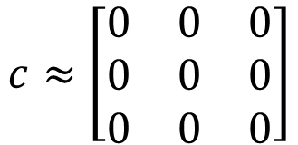
Line Calculation Example
c =
-0.0000 + j0.1074 0.0000 - j0.0348 0.0000 - j0.0133
0.0000 - j0.0348 -0.0000 + j0.1132 0.0000 - j0.0221
0.0000 - j0.0133 0.0000 - j0.0221 -0.0000 + j0.1021
X 10⁻⁴
$$c≈\left[\begin{matrix}0 & 0 & 0 \\ 0 & 0 & 0 \\ 0 & 0 & 0\end{matrix}\right]$$

Slide 41
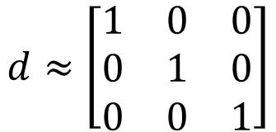
Line Calculation Example
d =
1.0000 + j0.0000 -0.0000 - j0.0000 -0.0000 + j0.0000
-0.0000 - j0.0000 1.0000 + j0.0000 -0.0000 + j0.0000
-0.0000 + j0.0000 -0.0000 + j0.0000 1.0000 + j0.0000
$$d≈\left[\begin{matrix}1 & 0 & 0 \\ 0 & 1 & 0 \\ 0 & 0 & 1\end{matrix}\right]$$

Slide 42
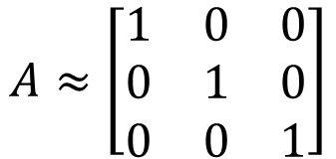
Line Calculation Example
A =
1.0000 + j0.0000 -0.0000 - j0.0000 -0.0000 + j0.0000
-0.0000 - j0.0000 1.0000 + j0.0000 -0.0000 + j0.0000
-0.0000 + j0.0000 -0.0000 + j0.0000 1.0000 + j0.0000
$$A≈\left[\begin{matrix}1 & 0 & 0 \\ 0 & 1 & 0 \\ 0 & 0 & 1\end{matrix}\right]$$

Slide 43

Line Calculation Example
B =
0.8658 + j2.0438 0.2947 + j0.9521 0.2900 + j0.7311
0.2947 + j0.9521 0.8831 + j1.9871 0.2986 + j0.8043
0.2900 + j0.7311 0.2986 + j0.8043 0.8733 + j2.0192
$$B=a^{−1}b≈b$$

Slide 44
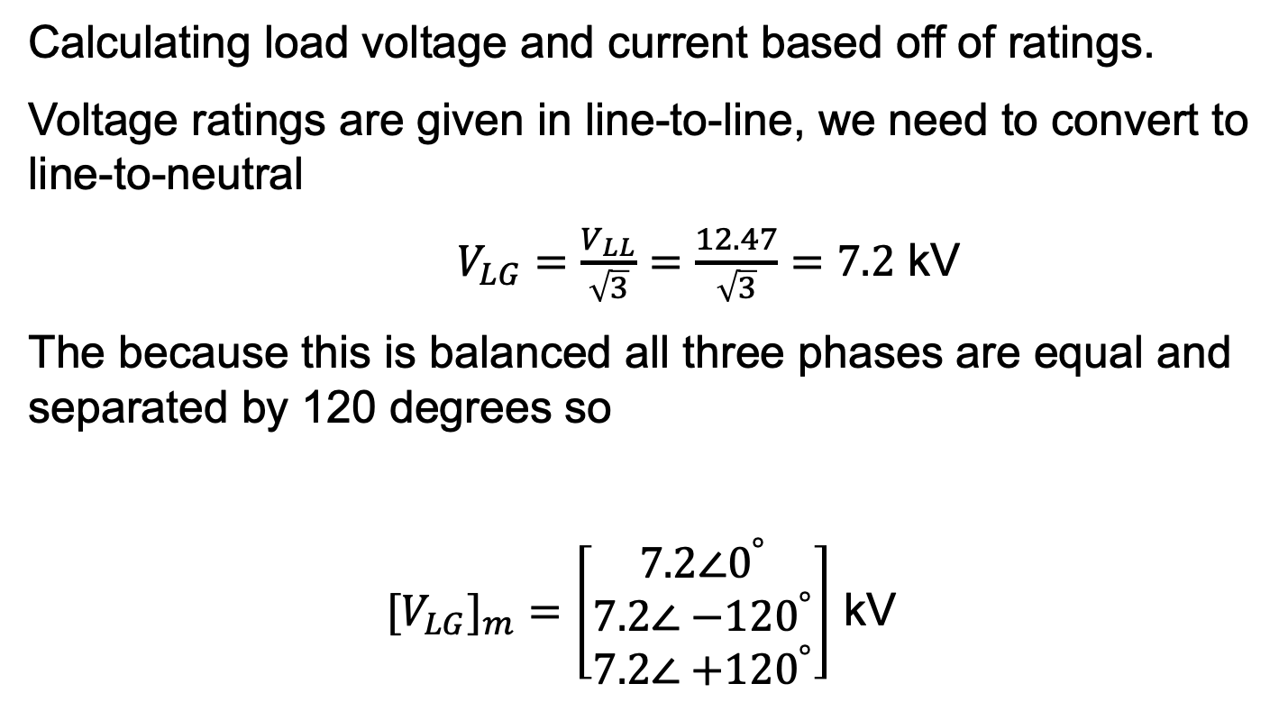
Line Calculation Example
Calculating load voltage and current based off of ratings.
Voltage ratings are given in line-to-line, we need to convert to line-to-neutral
$V_{LG}=\frac{V_{LL}}{\sqrt{3}}=\frac{12.47}{\sqrt{3}}=7.2$ kV
The because this is balanced all three phases are equal and separated by 120 degrees so
${[V}_{LG}]_{m}=\left[\begin{matrix}7.2∠0^{°} \\ 7.2∠{−120}^{°} \\ 7.2∠{+120}^{°}\end{matrix}\right]$ kV

Slide 45
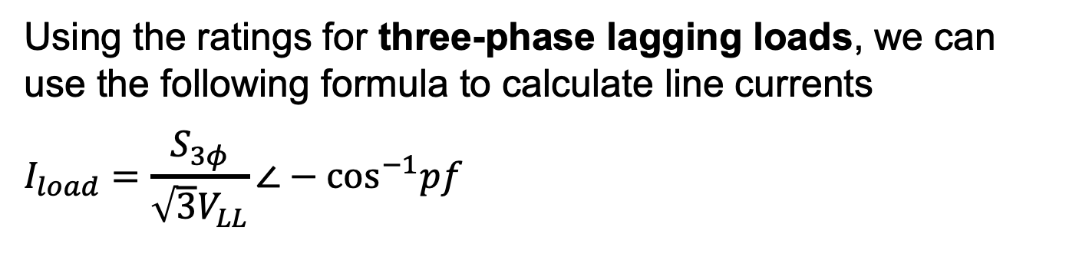
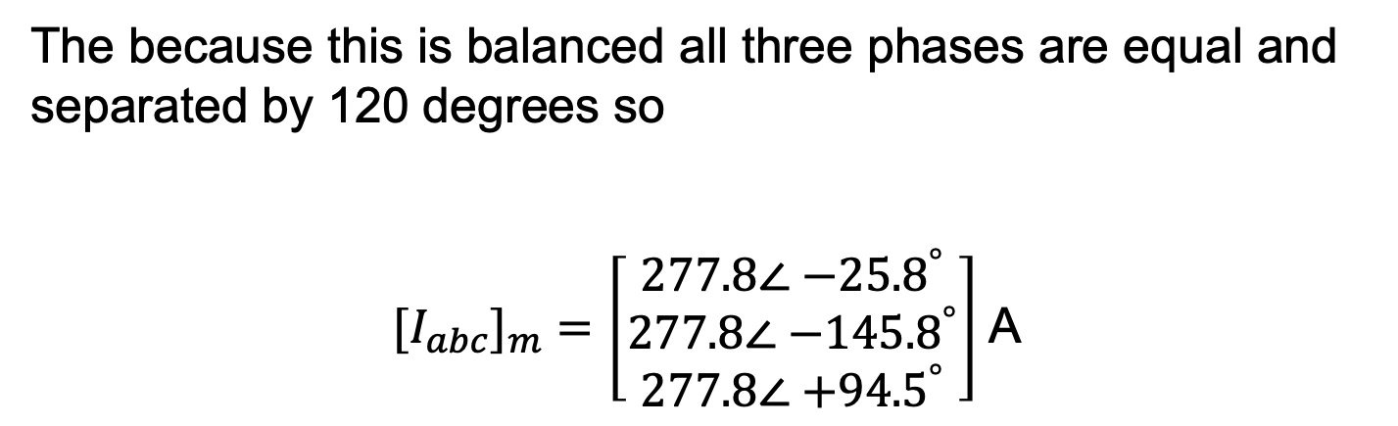
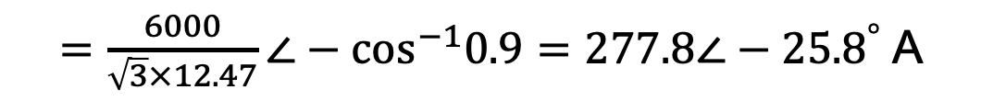
Line Calculation Example
Using the ratings for three-phase lagging loads, we can use the following formula to calculate line currents
$$I_{load}=\frac{S_{3φ}}{\sqrt{3}V_{LL}}∠−{\text{cos}}^{−1}pf$$
$=\frac{6000}{\sqrt{3}×12.47}∠−{\text{cos}}^{−1}0.9=277.8∠−{25.8}^{°}$ A
The because this is balanced all three phases are equal and separated by 120 degrees so
${[I}_{abc}]_{m}=\left[\begin{matrix}277.8∠{−25.8}^{°} \\ 277.8∠{−145.8}^{°} \\ 277.8∠{+94.5}^{°}\end{matrix}\right]$ A

Slide 46
Line Calculation Example
Now using the following equation we can calculate the voltage and current at node n using:

Slide 47
Line Calculation Example
Source line to neutral voltages:
abs(Vlg_n)
ans =
1.0e+03 *
7.5387
7.4513
7.4851
angle(Vlg_n)*180/pi
ans =
1.5730
-118.3011
121.9320

Slide 48

Line Calculation Example
To calculate the line to line voltages we use:

Slide 49
Line Calculation Example
Source line to line voltages:
abs(Vll_n)
ans =
1.0e+04 *
1.2974
1.2920
1.3034
angle(Vll_n)*180/pi
ans =
31.4426
-88.1093
151.8697

Slide 50
Line Calculation Example
Source line currents:
abs(In)
ans =
277.7393
277.7554
277.7601
angle(In)*180/pi
ans =
-25.8253
-145.8221
94.1748

Slide 51
Line Calculation Example
Now using the following equation we can calculate the voltage unbalance using:

Slide 52
Line Calculation Example
Now finding the voltage unbalance for the source
dV =
46.9888
40.4035
6.5853
Vunbalance =
0.006272
$$V_{unbalance}=0.6272 \%$$

